Slide 1
JavaScript
Presented By:
Ankit Singh (0801IT211015)
Animesh Shrivastava (0801IT211013)
Ashmit Sharma (0801IT211022)

Slide 2
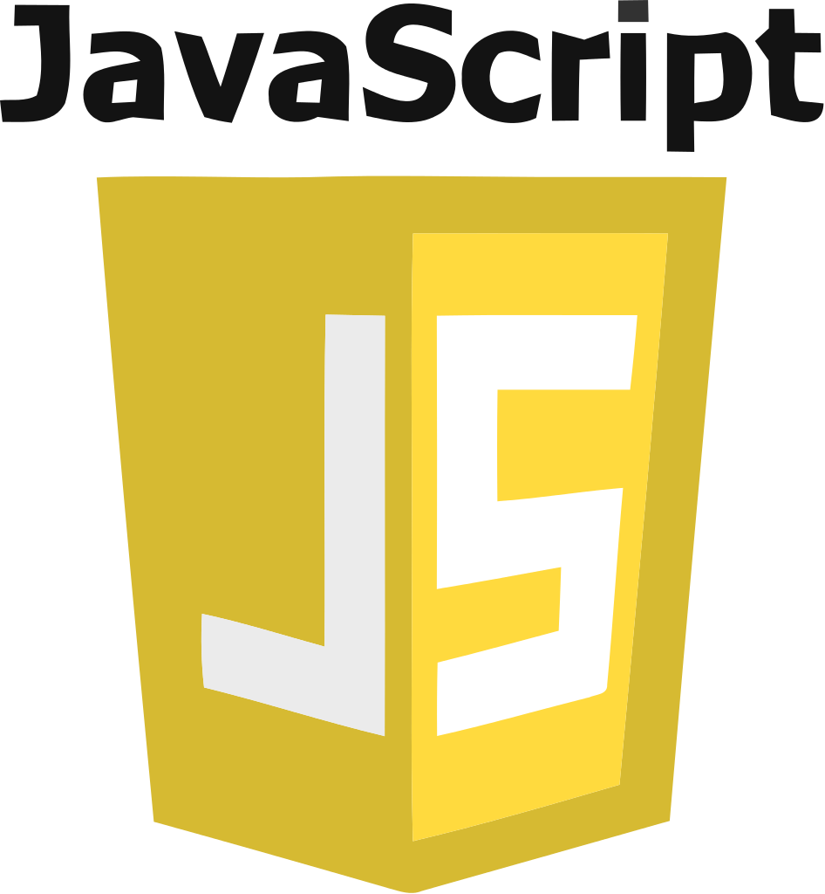
What is JavaScript
JavaScript is a scripting or programming language that allows you to implement complex features on web pages.
JavaScript is dynamic, and widely-used programming language for web development.
It enables interactive and dynamic content creation, user interaction and manipulation of web page elements.
It can be operated in both browser and server environments.

Slide 3

History of JavaScript
JavaScript, created by Brendan Eich in 1995, was initially developed for Netscape Navigator. Originally named "Mocha," it aimed to add dynamic content to static web pages. Renamed JavaScript, it gained popularity due to its integration with Microsoft Internet Explorer and eventual standardization as ECMAScript. Today, it's vital in web development for both client and server-side applications.
Brendan Eich

Slide 4
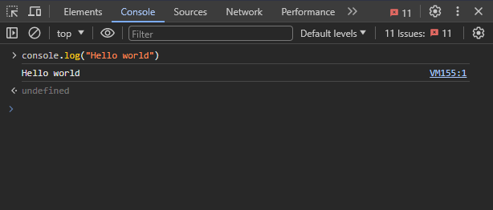
Where to Run JavaScript Code
Web Browsers:
Browser Console: Every major web browser (like Chrome, Firefox, Safari, and Edge) provides a developer console where you can directly run JavaScript code. Just open the browser, right-click on the page, select "Inspect" or "Inspect Element," and navigate to the "Console" tab.
Integrated Development Environments (IDEs):
Code Editors: Use code editors like Visual Studio Code, Sublime Text, Atom, or others to write and run JavaScript code. These editors often have extensions or plugins that provide a more convenient development environment.
Online Editors: There are online code editors like JSFiddle, CodePen, and Repl.it where you can write and run JavaScript code directly in your web browser.

Slide 5
JavaScript Engine
Components of JavaScript Engines
Popular JavaScript Engines
A JavaScript engine is a program or an integral part of a web browser that interprets and executes JavaScript code. It plays a crucial role in running JavaScript applications on various platforms.
Parser:
Interpreter:
Memory Heap:
Call Stack:
Garbage Collector:
V8 (Used in Google Chrome)
SpiderMonkey (Used in Mozilla Firefox)
JavaScriptCore (Used in Safari)
Chakra (Used in older versions of Microsoft Edge)

Slide 6
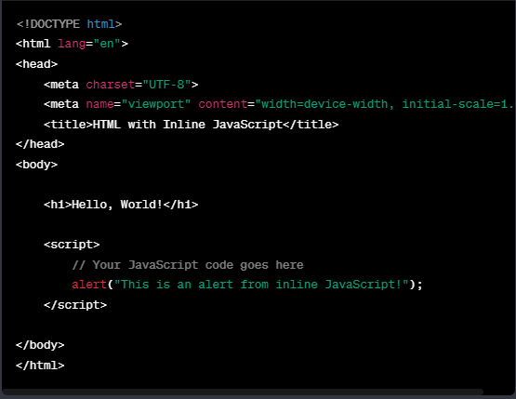
Methods to Connect HTML and JavaScript
1. Inline JavaScript:
You can include JavaScript code directly within your HTML file using the <script> tag

Slide 7
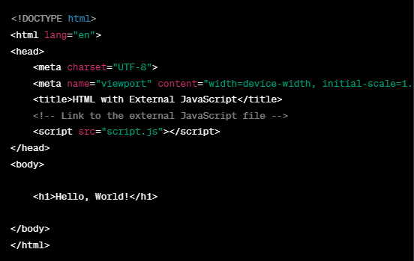
Methods to Connect HTML and JavaScript
2. External JavaScript File:
You can also create a separate JavaScript file and link it to your HTML file using the <script> tag's src attribute

Slide 8
Data Types in JavaScript
Primitive Data Types:
String: Represents textual data. Example: "Hello, World!".Number: Represents numeric data. Example: 42.
Boolean: Represents true or false values.
Undefined: Represents the absence of a value or uninitialized variable.
Null: Represents the intentional absence of any object value.
Complex Data Types:
Object: Represents a collection of key-value pairs. Example: { name: "John", age: 25 }.
Array: Represents an ordered list of values. Example: [1, 2, 3].
Function: Represents a reusable block of code. Functions are first-class citizens in JavaScript.
Maps: Maps are a collection of key-value pairs where keys can be of any data type.
Sets: Sets are collections of unique values, and they can store values of any data type.

Slide 9
How to Declare Variables in JavaScript
Using “var”:
Variables declared with var are function-scoped or globally scoped but not block-scoped.
var x = 5;
Using “let”:
let allows block-scoping, making it more versatile than var.
let y = "Hello"
Using “const”:
Declares a constant variable. The value cannot be reassigned after initialization.
const PI = 3.14;

Slide 10
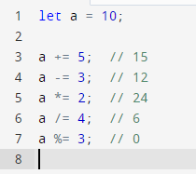
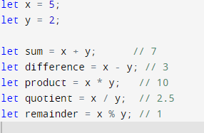
Operators in JavaScript
1. Arithmetic Operators:
Definition: Perform basic mathematical operations.
2. Assignment Operators:
Definition: Assign values to variables.

Slide 11
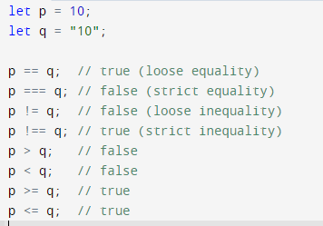
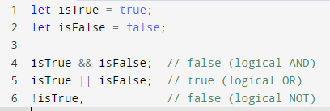
Operators in JavaScript
3. Comparison Operators:
Definition: Compare values and return a boolean result.
4. Logical Operators:
Definition: Perform logical operations and return boolean values.

Slide 12
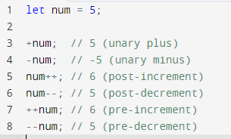

Operators in JavaScript
5. Unary Operators:
Definition: Operate on a single operand.
6. Conditional (Ternary) Operator:
Definition: A concise way to write conditional statements.

Slide 13
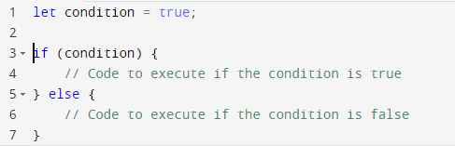
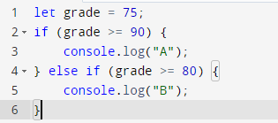
Control Flow
Control flow in JavaScript refers to the order in which statements are executed in a program.
Conditional Statements
if Statement:
Executes a block of code if a specified condition is true.
b. else if Statement:
Adds additional conditions to be checked if the preceding if or else if statements are false.

Slide 14
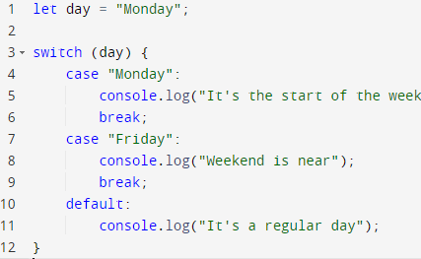
Control Flow
2. Switch Statement
Evaluates an expression against multiple possible case values and executes the corresponding block of code.

Slide 15

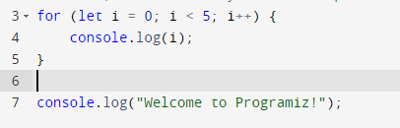
Control Flow
3. Loops: Loops in JavaScript are used to repeatedly execute a block of code until a specified condition is met.
a) for Loop:
The for loop is used to iterate over a sequence (that is either numeric or can be converted to numeric) for a specified number of times.

Slide 16
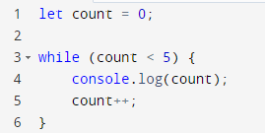
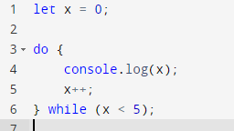
Control Flow
b) while Loop:
The while loop continues to execute a block of code as long as the specified condition is true.
c) do-while Loop:
The do-while loop is similar to the while loop, but it guarantees that the block of code is executed at least once before checking the condition.

Slide 17
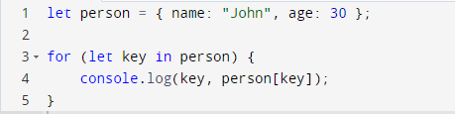
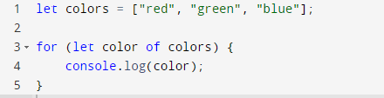
Control Flow
d) for in Loop:
The for...in loop in JavaScript is used to iterate over the enumerable properties of an object. It provides an easy way to access each key (property) of an object.
e) for of Loop:
The for...in loop in JavaScript is used to iterate over the enumerable properties of an object. It provides an easy way to access each key (property) of an object.

Slide 18

Higher Order Functions
Higher-order functions are functions in JavaScript that can take other functions as arguments or return functions as results.
1. map():
The map function creates a new array by applying a provided function to each element in the existing array.

Slide 19


Higher Order Functions
2. filter():
The filter function creates a new array containing only the elements that satisfy a given condition specified by a provided function.
3. reduce():
The reduce function is used to accumulate a single result by applying a function to each element of an array. It reduces the array to a single value.

Slide 20
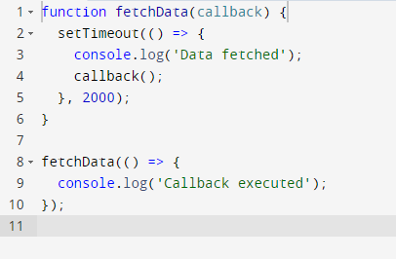
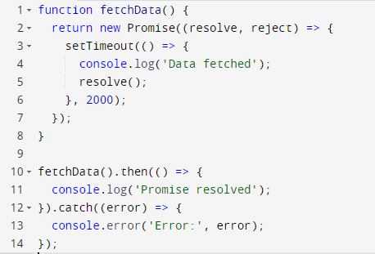
Asynchronous JavaScript
Asynchronous JavaScript is a programming paradigm that allows certain operations to be executed independently of the main program flow, allowing non-blocking behavior. Asynchronous operations are common in scenarios like fetching data from a server, reading files, or handling user input.
1. Callbacks: Callbacks are functions passed as arguments to other functions, to be executed later, often after an asynchronous operation completes.
2. Promises: Promises provide a cleaner way to handle asynchronous operations, allowing better error handling and chaining.

Slide 21
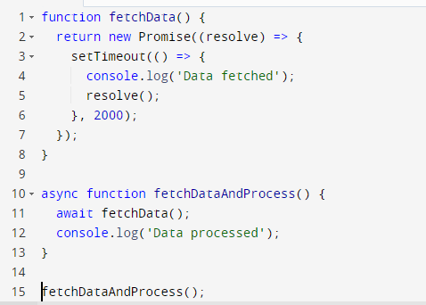
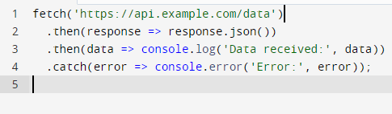
Asynchronous JavaScript
3. async/await:
async functions and await expressions simplify working with Promises, making asynchronous code appear more like synchronous code.
4. Fetch API:
The Fetch API is a modern alternative to XMLHttpRequest, providing a more powerful and flexible way to make asynchronous requests.

Slide 22
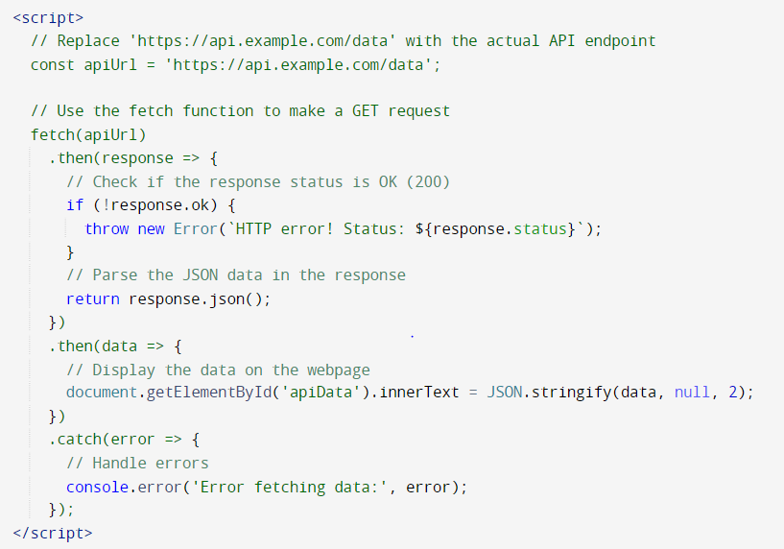
How to Call API Using JavaScript
Calling an API using JavaScript is commonly done using the fetch function, which is a modern and powerful way to make asynchronous HTTP requests.

Slide 23
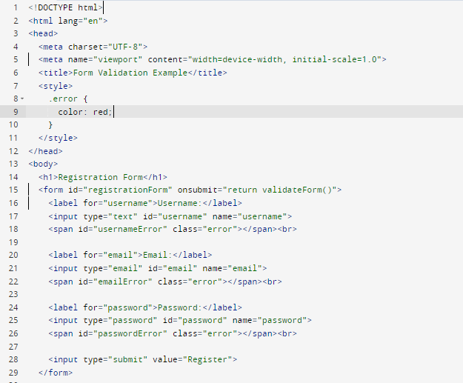
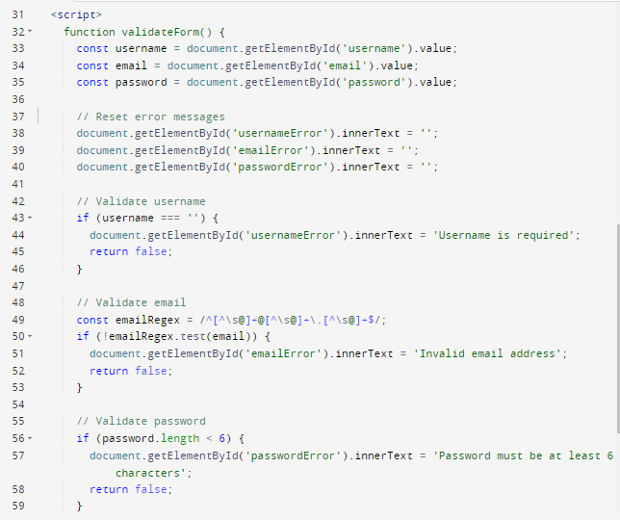
Form Validation Using JavaScript

